Slide 1

Essentials of Economics
Seventh Edition
Chapter 12
GDP: Measuring Total Production and Income
Copyright © 2021, 2019, 2017 Pearson Education, Inc. All Rights Reserved.
Notes:
If this PowerPoint presentation contains mathematical equations, you may need to check that your computer has the following installed:
1) MathType Plugin
2) Math Player (free versions available)
3) NVDA Reader (free versions available)

Slide 2
Chapter Outline
12.1 Gross Domestic Product Measures Total Production
12.2 Does GDP Measure What We Want It to Measure?
12.3 Real GDP versus Nominal GDP
12.4 Other Measures of Total Production and Total Income

Slide 3
Some Important Macroeconomic Terms
Business cycle: Alternating periods of economic expansion and economic recession.
Expansion: The period of a business cycle during which the total production and total employment are increasing.
Recession: The period of a business cycle during which total production and total employment are decreasing.
Economic growth: The ability of an economy to produce increasing quantities of goods and services.
Inflation rate: The percentage increase in the price level from one year to the next.

Slide 4
12.1 Gross Domestic Product Measures Total Production
The most common measure used by economists of overall economic activity in an economy is gross domestic product, or GDP.
Gross domestic product (GDP): the market value of all final goods and services produced in a country during a period of time, typically one year.
We will examine each of the parts of this definition in turn.

Slide 5
Avoiding Double Counting
A final good or service is a good or service purchased by a final user. These are what are used to calculate GDP.
Why? If we counted intermediate goods and services as well, ones that were inputs for another good or service, such as a tire on a truck, then we would end up double counting.
Example: If we counted the value of the ice cream bought by a store and the value of that ice cream when it was sold to a consumer, we would be double counting the wholesale value of the ice cream.

Slide 6
Production and Income
There are two main conceptual ways to measure the total economic activity in an economy: total production or total income.
When we measure one, we are also measuring the other. Why?
Everything produced and sold constitutes income for someone so we can measure the value of products produced and sold or the value of incomes.
Each is a valid way of measuring economic activity.

Slide 7
Measuring GDP
To measure GDP, the Bureau of Economic Analysis (BEA) in the Department of Commerce measures four major categories of expenditures:
Personal consumption expenditures, or consumption (C)
Gross private domestic investment, or investment (I)
Government consumption and gross investment, or government purchases (G)
Net exports of goods and services, or net exports (NX)
GDP can be expressed as the sum of these:
Y = C + I + G + NX

Slide 8
Consumption or “C”
Consumption is spending by households on goods and services, not including spending on new houses (which are counted instead in investment).
In BEA statistics, consumption is further divided into expenditure on
Services, such as medical care, education, and haircuts
Nondurable goods, such as food and clothing, and
Durable goods, such as automobiles and furniture.

Slide 9
Investment or “I”
Investment is spending by firms on new factories, office buildings, machinery, and additions to inventories, plus spending by households and firms on new houses.
The BEA measures the following categories of investment:
Business fixed investment, such as new factories, office buildings, machinery, and research and development.
Residential investment, i.e. new single-family and multi-unit houses.
Changes in business inventories, i.e. goods that have been produced but not yet sold.
Note: in economics, “Investment” does not mean buying stocks and bonds, etc., like it does in finance.

Slide 10
Government Purchases or “G”
Government purchases are spending by federal, state, and local governments on goods and services.
This includes both government consumption (like teachers’ salaries and office supplies) and government investment (like highways and military bases).
This does not include transfer payments, since those do not result in immediate production of new goods and services.

Slide 11
Net Exports “NX”
Net exports are exports minus imports.
This difference might be positive or negative; in recent years, this has been negative in the United States.
Since we want to count domestic production (production in the United States), we add up the value of the goods and services sold to foreigners and subtract the value of the goods and services sold to Americans by foreigners.
An export is not counted otherwise (in C, I, or G) so we need to count it somehow as production.
An import is counted (in C, usually) but we are trying to measure domestic production, so we don’t want to count it. Subtracting it off achieves this goal.

Slide 12
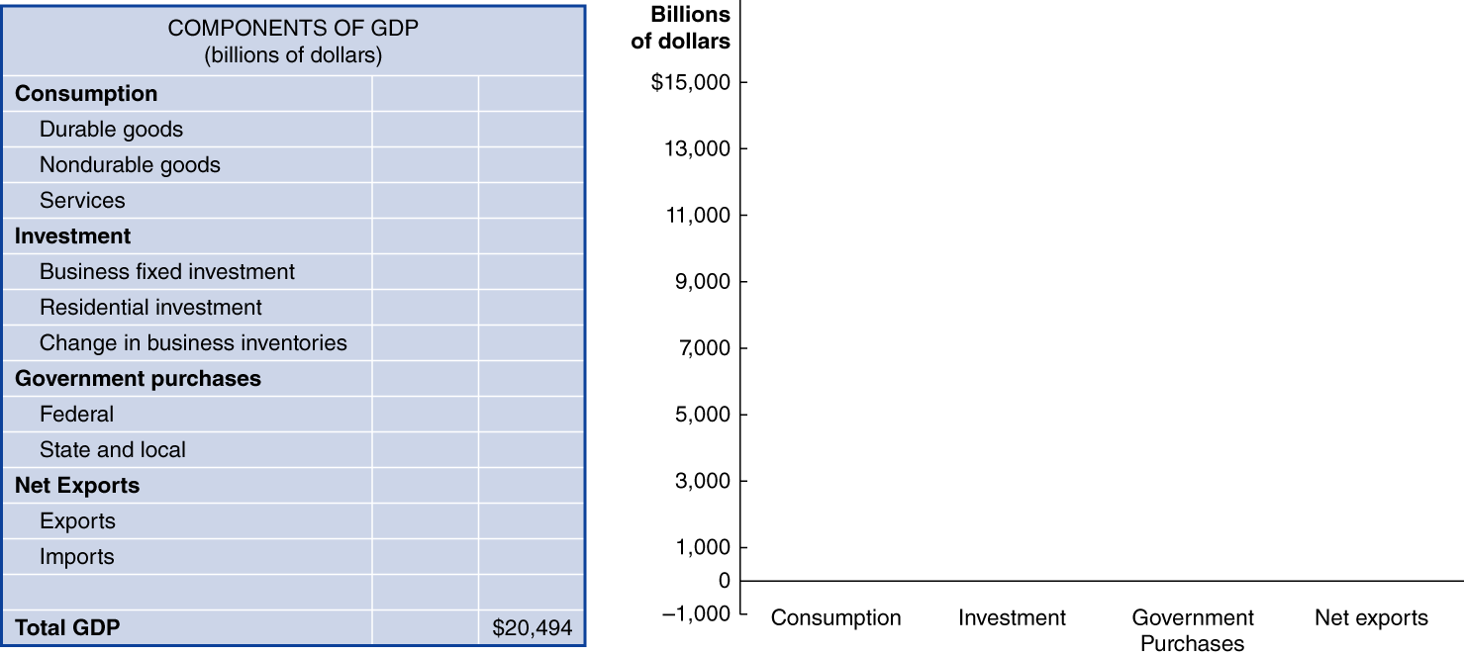
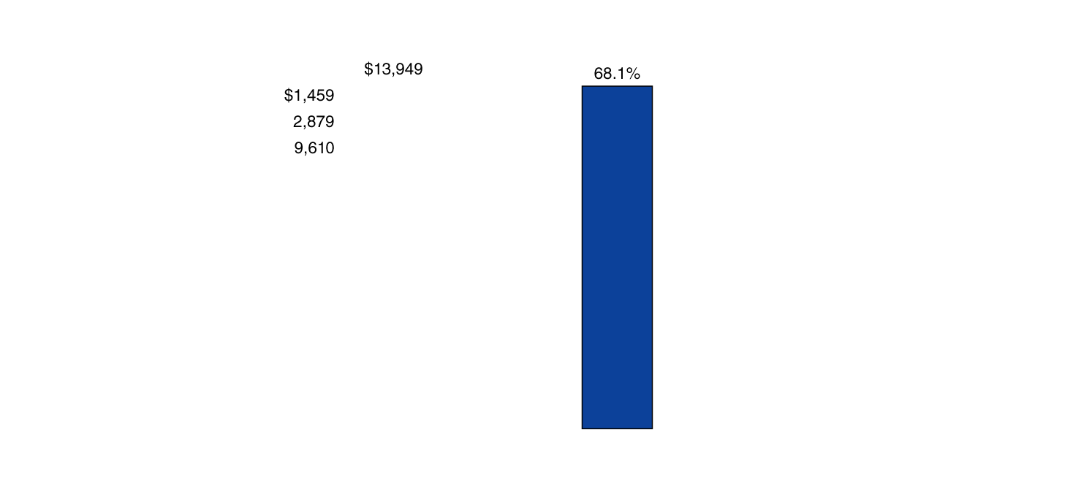
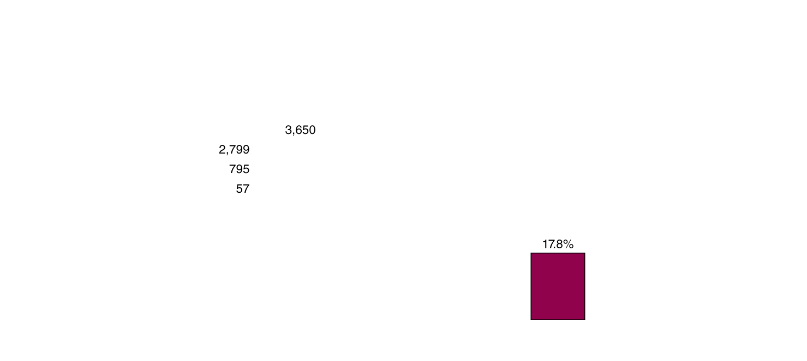
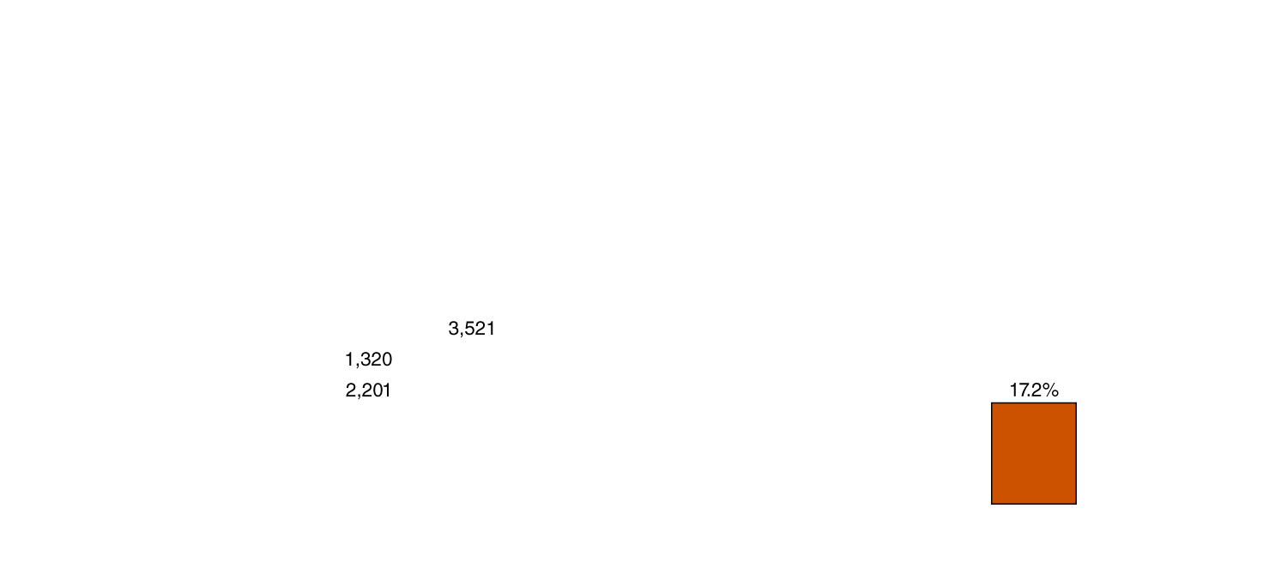
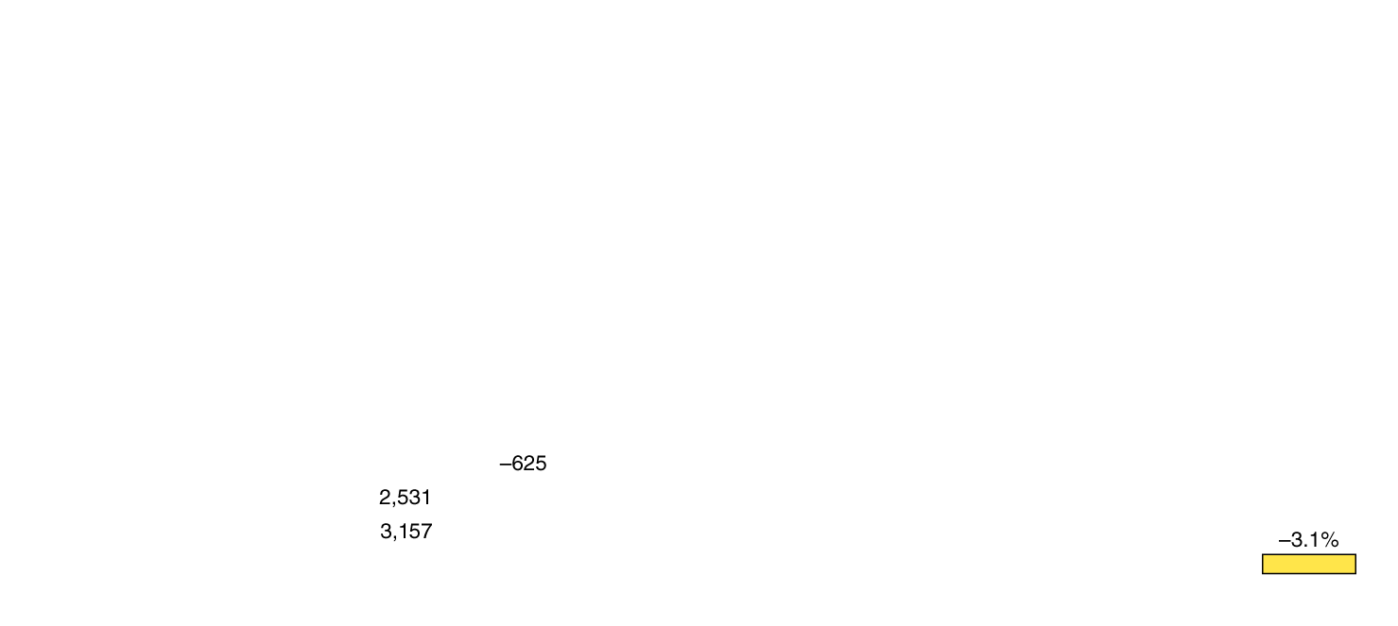
Figure 12.2 Components of GDP in 2018
Consumption is the largest component of GDP; within that, services are the largest component—almost half of GDP.
American net exports are negative, since the value of our imports exceeds the value of our exports.

Slide 13
Table 12.1 Calculating Value Added
Firm | Value of Product | Value Added | Blank
Cotton farmer | Value of raw cotton = $1 | Value added by cotton farmer | = $1
Textile mill | Value of raw cotton woven into cotton fabric = $3 | Value added by textile mill = ($3 − $1) | = $2
Shirt company | Value of cotton fabric made into a shirt = $15 | Value added by shirt company = ($15 − $3) | = $12
L.L.Bean | Value of shirt for sale on L.L.Bean’s Web site = $35 | Value added by L.L.Bean = ($35 − $15) | = $20
Blank | Total Value Added | Blank | = $35
An alternative method to measure GDP is to measure the value added: the market value a firm adds to a product.
The final selling price of a product must equal the sum of the values added to the product at each stage of production.
The table illustrates this method for a shirt sold on L.L.Bean’s web site.

Slide 14
12.2 Does GDP Measure What We Want It to Measure?
Discuss whether GDP is a good measure of well-being.
GDP can be a useful tool to measure total output in an economy. Many people go further than this, interpreting GDP as a measure of the well-being of citizens.
However, GDP has shortcomings as both a
Measure of total production and a
Measure of well-being.

Slide 15
Underground economies
Two important types of production are omitted from the BEA’s measurement of GDP:
Household production, such as childcare, cleaning, and cooking is not typically paid for with money.
But such contributions are real—if performed by a non-household member, they would be paid for and counted in GDP.
Underground economy: Buying and selling of goods and services that are concealed from the government to avoid taxes or regulations, or because the goods and services are illegal.
This may be 10 percent or more of the economy in America and substantially more in low-income countries.

Slide 16
GDP per capita as a Measure of Well-Being
GDP per capita (i.e. GDP divided by population) is often used to represent differences in standards of living from country to country.
While imperfect, it allows us to compare countries of different population levels.
For example, the countries of China, India, and the United States have very different populations. Therefore, it wouldn’t make sense to compare the total GDP of each to one another.

Slide 17
12.3 Real GDP versus Nominal GDP
Discuss the difference between real GDP and nominal GDP.
Suppose GDP increases; is the increase in GDP due to production increasing, or due to prices increasing?
To separate these effects, the BEA calculates both nominal GDP—the value of final goods and services evaluated at current-year prices—and real GDP—the value of final goods and services evaluated at base-year prices.
The choice of a base-year is arbitrary; we might use any year’s prices to compare real GDP. The current standard is 2012.
Unfortunately, the relative prices also change from year to year, distorting real GDP calculations. Since 1996, the BEA has overcome this problem by using chain-weighted prices, using previous-year prices to adjust current-year production.

Slide 18
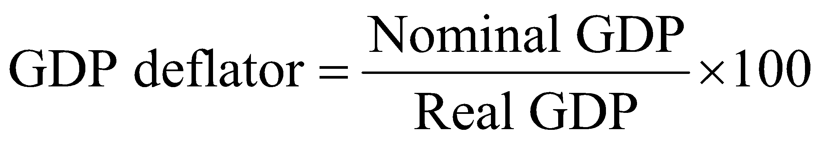
The GDP Deflator
Economists and policy-makers are interested in the price level: a measure of the average prices of goods and services in the economy.
Why? Stable prices are desirable because they allow households and firms to plan for the future appropriately.
In order to know whether we are achieving price stability, we need to measure the price level.
One way to do this is using the GDP deflator: a measure of the price level, calculated by dividing nominal GDP by real GDP and multiplying by 100:
Since nominal and real GDP will be the same in the base year, the GDP deflator will be 100 in the base year.

Slide 19
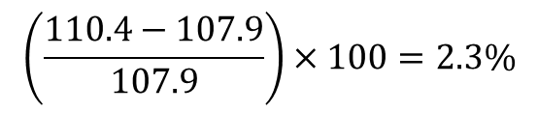
Calculating GDP Deflator: An Example
Blank | 2017 | 2018
Nominal GDP | $ 19,485 billion | $ 20,494 billion
Real GDP | $ 18,051 billion | $ 18,566 billion
Formula | Applied to 2017 | Applied to 2018
The first table gives nominal and real GDP for 2017 and 2018.
We can use this to calculate the GDP deflator in each year.
The GDP deflator increased from 107.9 to 110.4:
So we can say the price level rose by 2.3% over this period.

Slide 20
12.4 Other Measures of Total Production and Total Income
Describe other measures of total production and total income.
Each quarter, the BEA publishes the National Income and Product Accounts tables. These include GDP computations but also:
Gross national product (GNP): Production performed by citizens of a nation, including overseas production
National income: GDP minus the consumption of fixed capital; i.e. GDP minus depreciation
Personal income: Income received by households; includes transfer payments but excludes firms’ retained earnings
Disposable personal income: Personal income minus personal tax payments; this measures the amount that households are able to spend or save

Slide 21

Copyright

